Slide 1

David Hoff
Maria Paiewonsky
Institute for Community Inclusion
University of Massachusetts, Boston www.communityinclusion.org
Disability Overview & Etiquette

Slide 2

Part 2 of a
3-Part Webinar
Series
Students with Disabilities:
Legal and Practical Issues
Disability Overview and Etiquette
Universal Design
(January 22nd - 3:00 to 4:15)

Slide 3
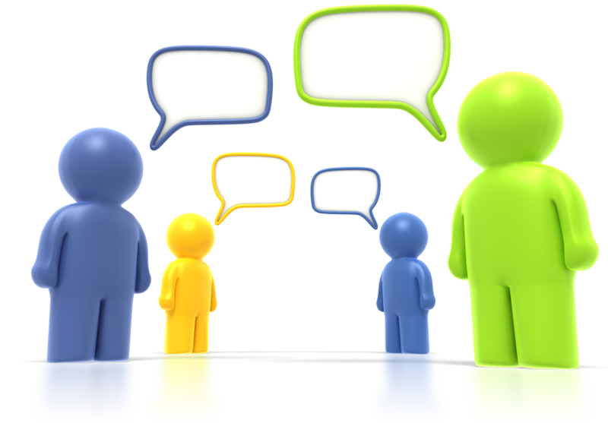
Discussion
When we say the term “disability”, what types of conditions come to mind?

Slide 4
Examples of Disabilities
paralysis
blindness or visual impairment
deafness or hard of hearing
intellectual disabilities
learning disabilities
psychiatric disabilities and mental health conditions
chemical sensitivity
epilepsy
head injuries
cerebral palsy
chronic health or physical issue
autism
HIV/AIDS

Slide 5
Old
Disability Paradigm
View/treat people with disabilities as “defective” in need of “fixing”
Disability = unable, incapable
Individual is to overcome limitations caused by disability in order to participate in society
Approach: out of sight, out of mind
SOURCE: Robert Silverstein, Emerging Disability Policy Framework

Slide 6
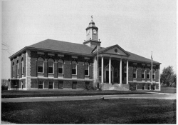
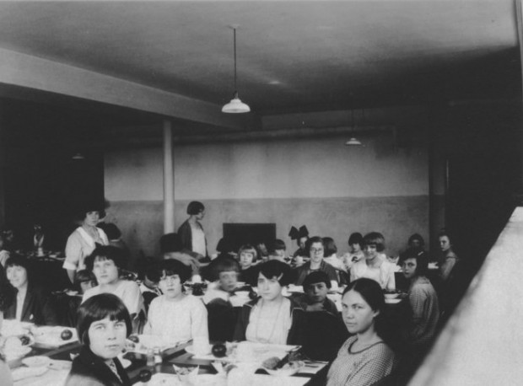
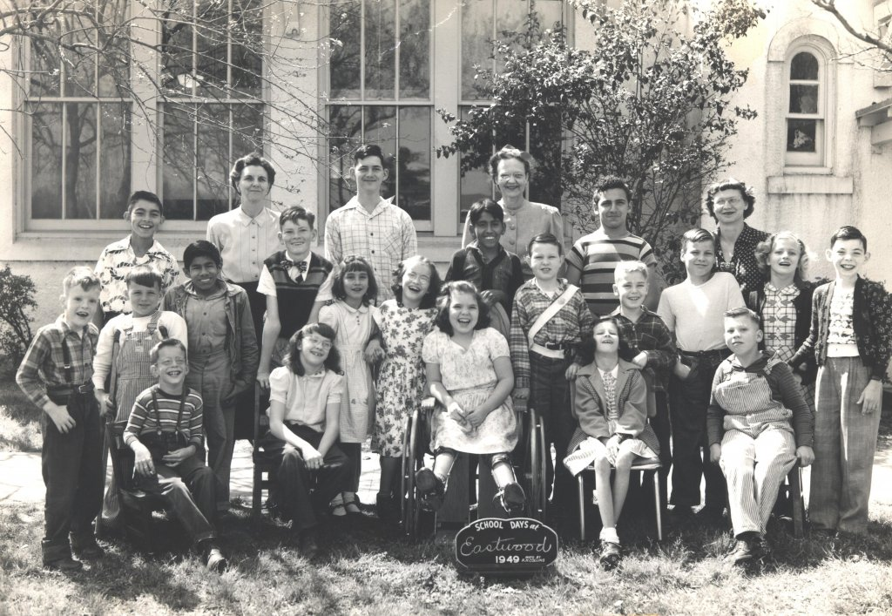
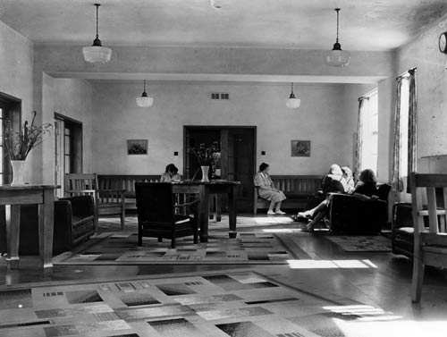
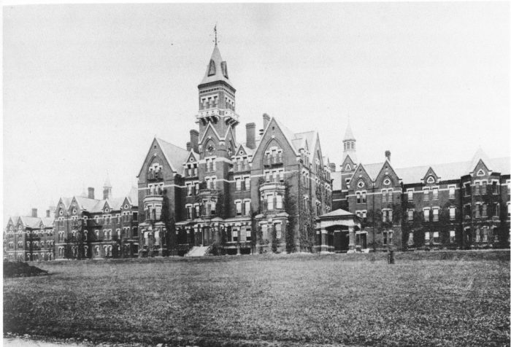

Slide 7
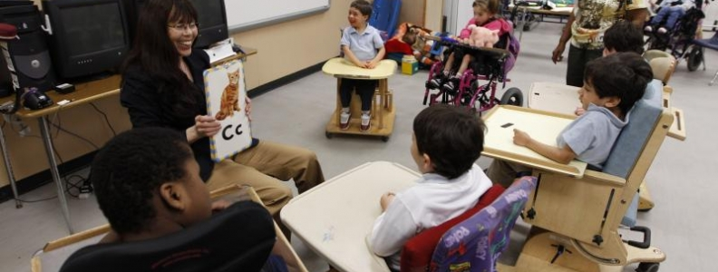

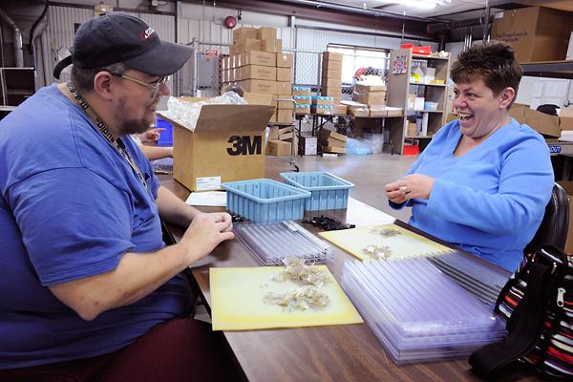

Slide 8
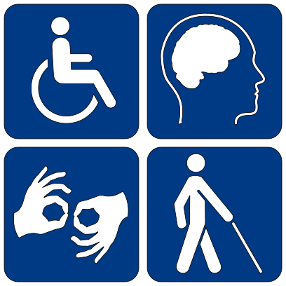
New Disability Paradigm
Disability: natural part of human experience that in no way diminishes a person’s right to fully participate in all aspects of life
Mission of public policy:
Fix environment, not individual
SOURCE: Robert Silverstein, Emerging Disability Policy Framework

Slide 9
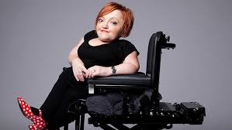
“My disability exists not because I use a wheelchair, but because the broader environment isn't accessible.”
Stella Young

Slide 10


Slide 11
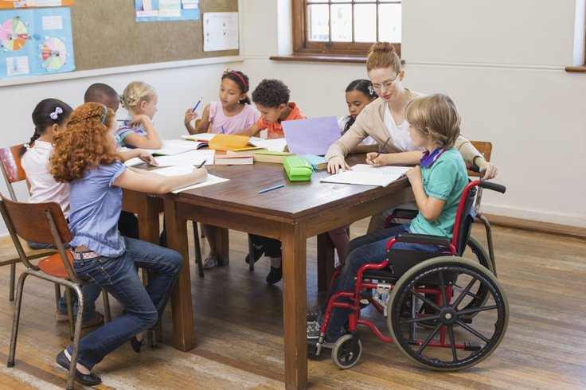
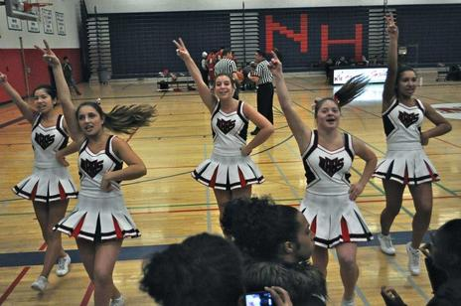
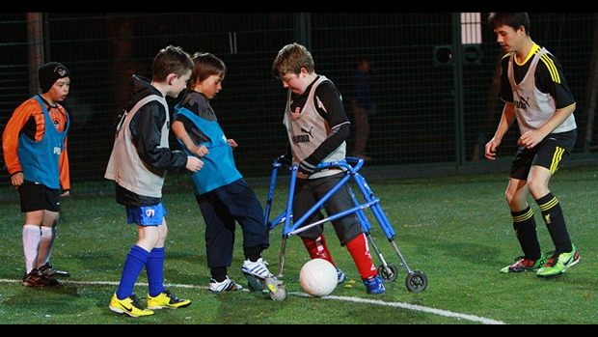


Slide 12
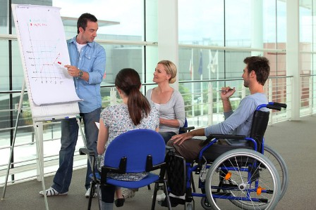
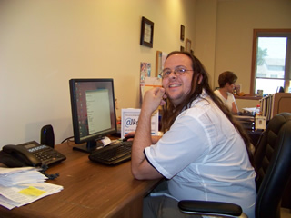
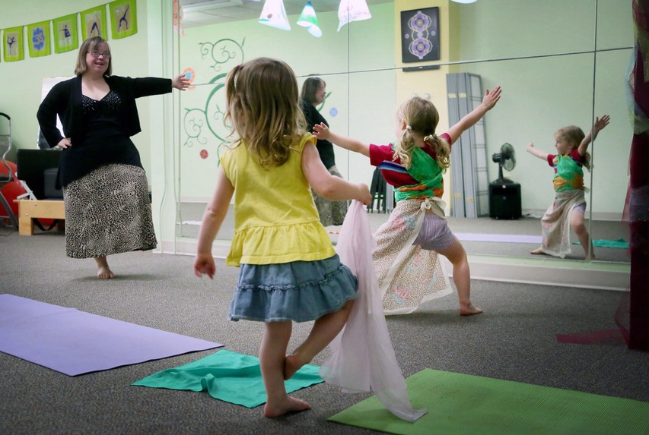
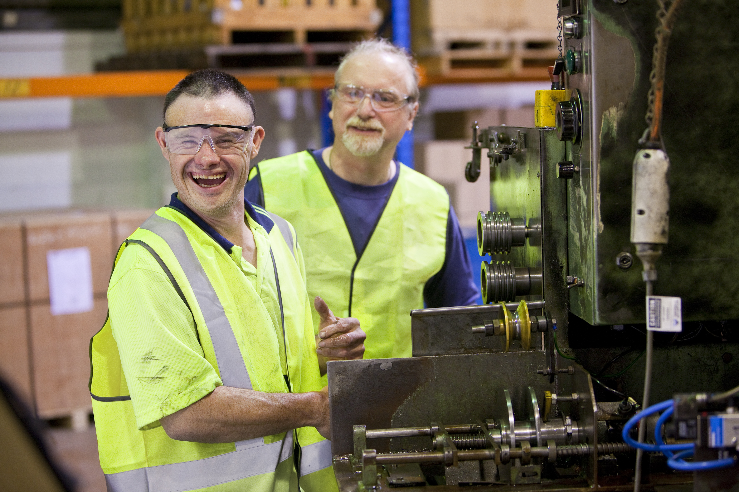

Slide 13
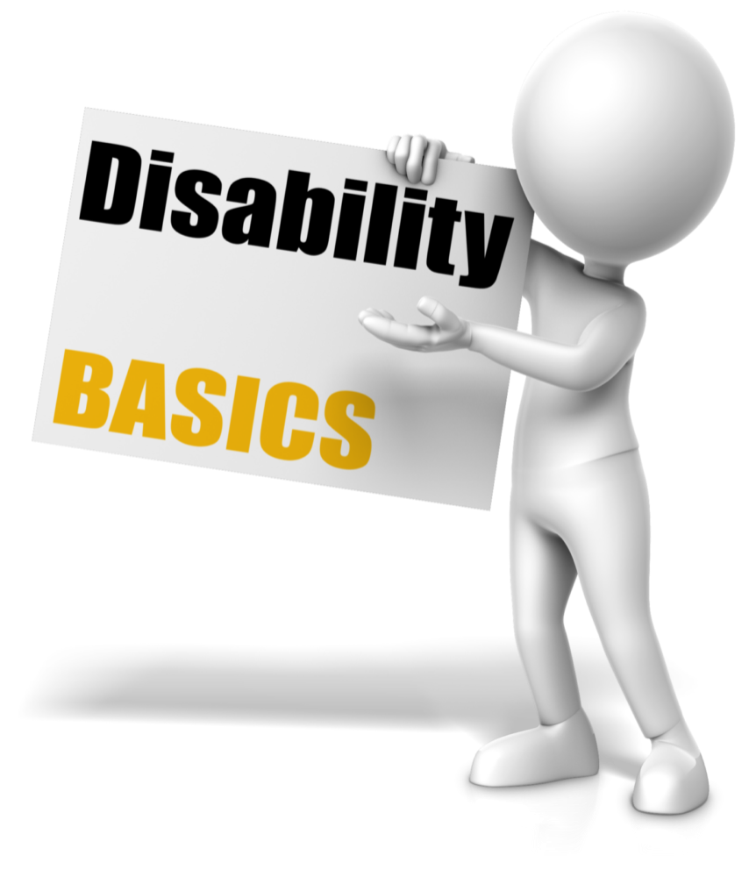
12% of people in Massachusetts identify as having a disability
Self-awareness and self-perception of disability varies
Many disabilities are non-apparent or “hidden”
Impact of disability on person’s life varies

Slide 14

People with Disabilities Are More Likely to Be:
Unemployed
Live in poverty
Poorly educated
Socially isolated

Slide 15
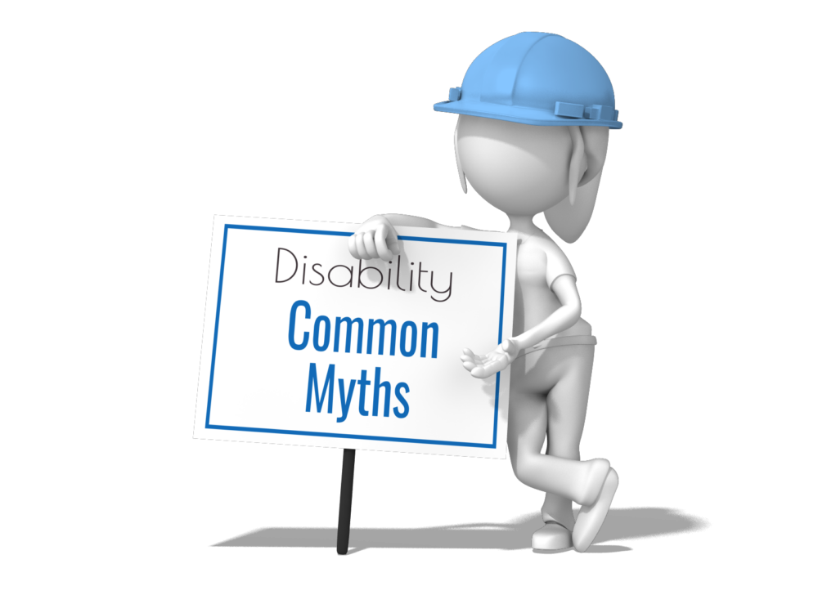
People are defined by their disability.
People with disabilities are “courageous”, “inspirational”.
People with intellectual disabilities are “eternal children”.
People with disabilities are “special”.
People with disabilities should be pitied.
People with mental health issues are dangerous.

Slide 16
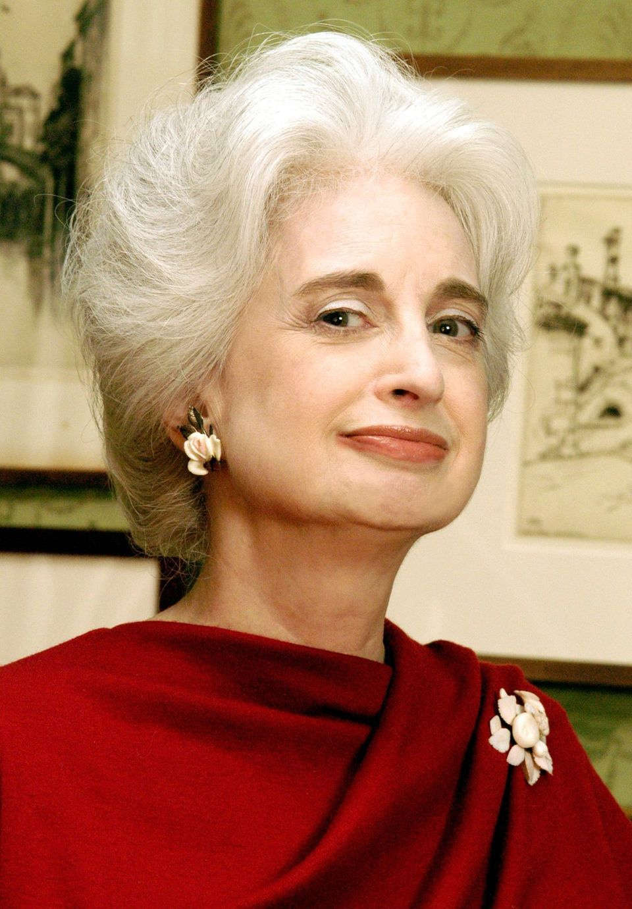
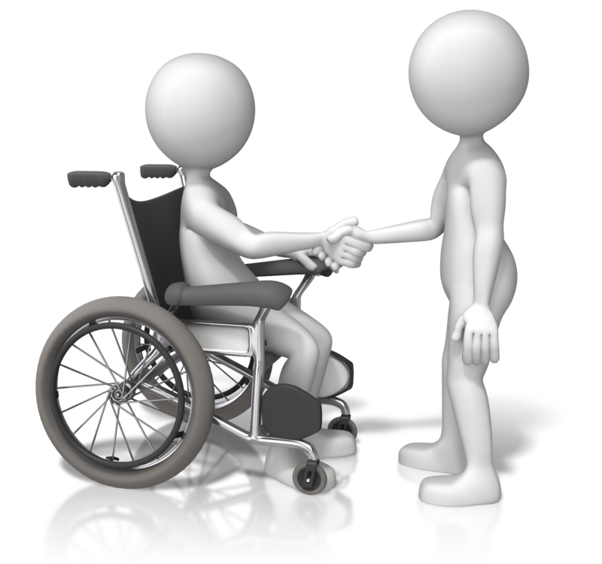
Basic Etiquette
Avoid stereotypes
Don’t presume someone does or does not have a disability
Don’t presume what someone needs or doesn’t need
Assume capability
Ask before helping
Don’t hesitate to ask
Respect and connect with the person as an individual
Respect people’s privacy
Don’t be patronizing

Slide 17
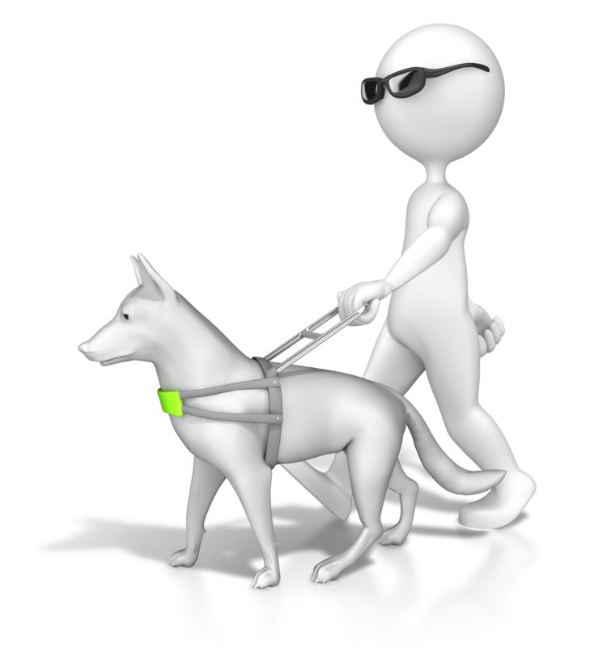
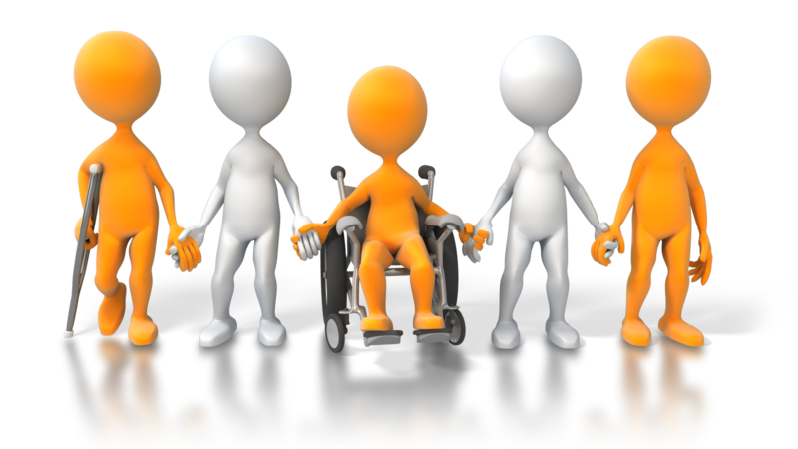
Language:
People First vs.
Identity First

Slide 18
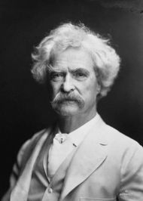


"The difference between the right word and the almost-right word is the difference between lightning and the lightning bug."
Mark Twain

Slide 19
Person First Language
Use person first in a phrase
Disability as a secondary aspect of a person
Examples:
  ”Person with a disability”
  “Woman with cerebral palsy”
  ”Student with an intellectual disability”
Affirms person has value and worth, and disability is separate from self-worth

Slide 20
Identity First Language
Use disability first in a phrase
Disability as an inherent aspect of a person
Examples:
  ”A disabled person”
  “Autistic person”
  ”Deaf person”
  “I’m bipolar”
Recognizes, affirms, validates an individual’s identity as a disabled person

Slide 21
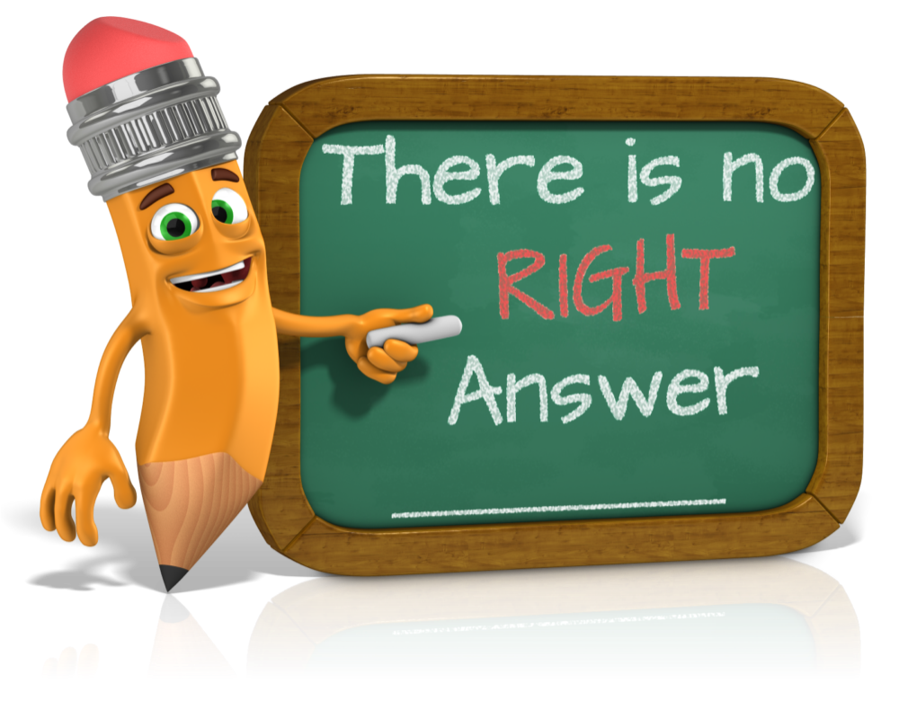

Slide 22
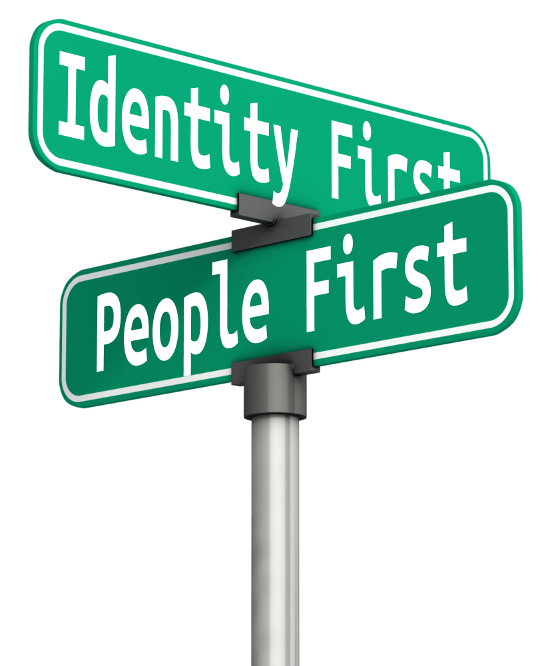
Tips for Navigating

Slide 23
There Is No “One Size
Fits All”
Approach
Don’t presume
Set ground rules for equal participation
Cultivate a safe space for voicing and respecting different perspectives
If there are varying opinions, alternate facilitation language frequently

Slide 24

Language That Should
NEVER
Be Used
“Handicap”
“Impaired”
“Wheelchair bound” or “Confined to a wheelchair”
“Suffers from”
The “R” word

Slide 25
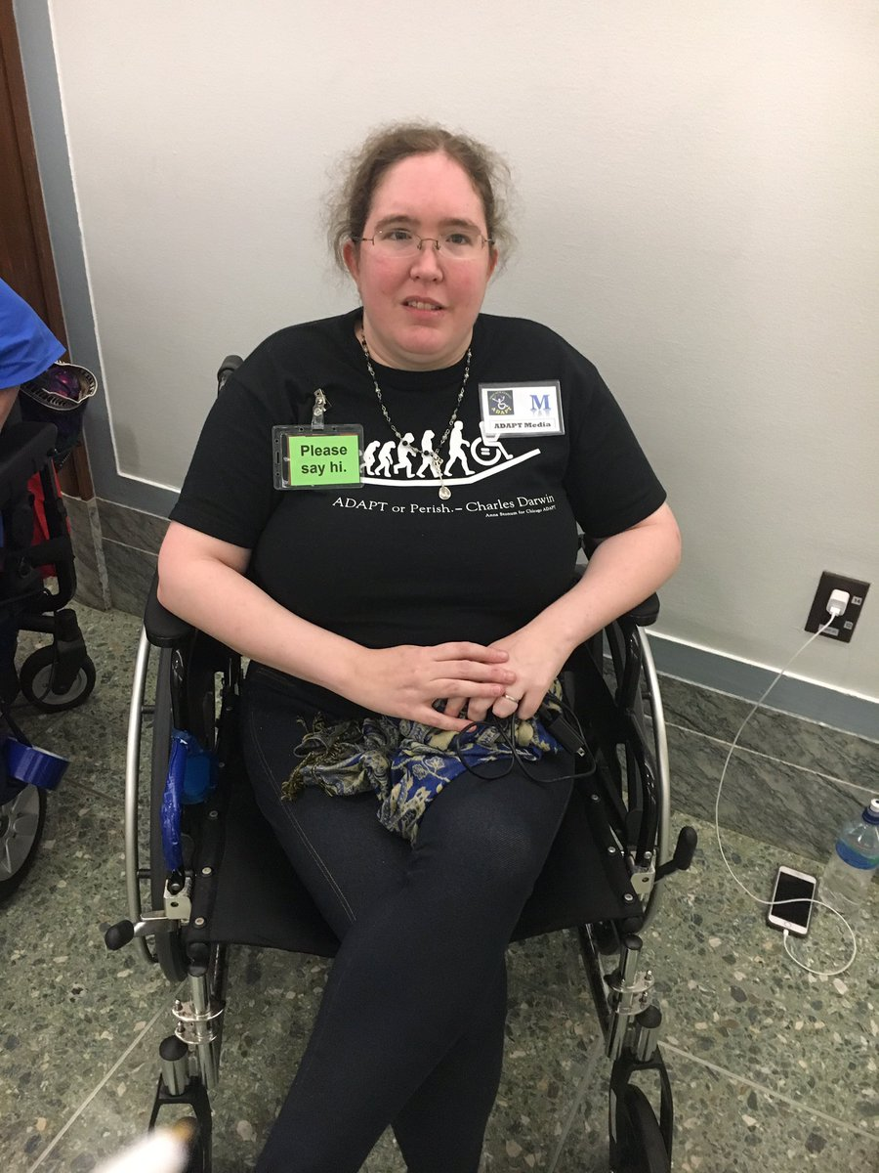
“I have a number of physical disabilities, and I have no preference.
What matters to me is that the surrounding conversation indicates that whoever I’m talking with sees me as a person and respects me fully as such.”
Irina Greenman

Slide 26
The Best Term to Use to Describe Someone With a Disability?
Their Name

Slide 27
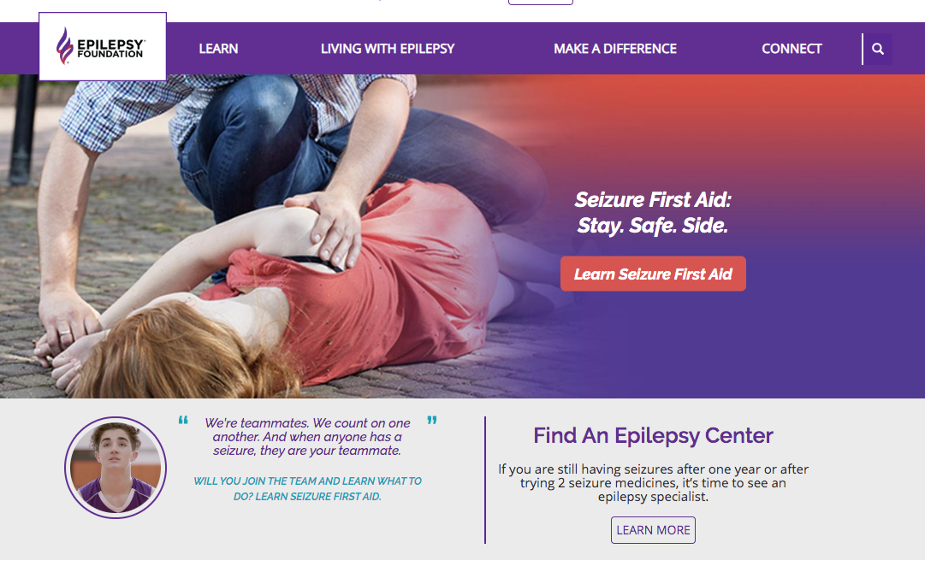
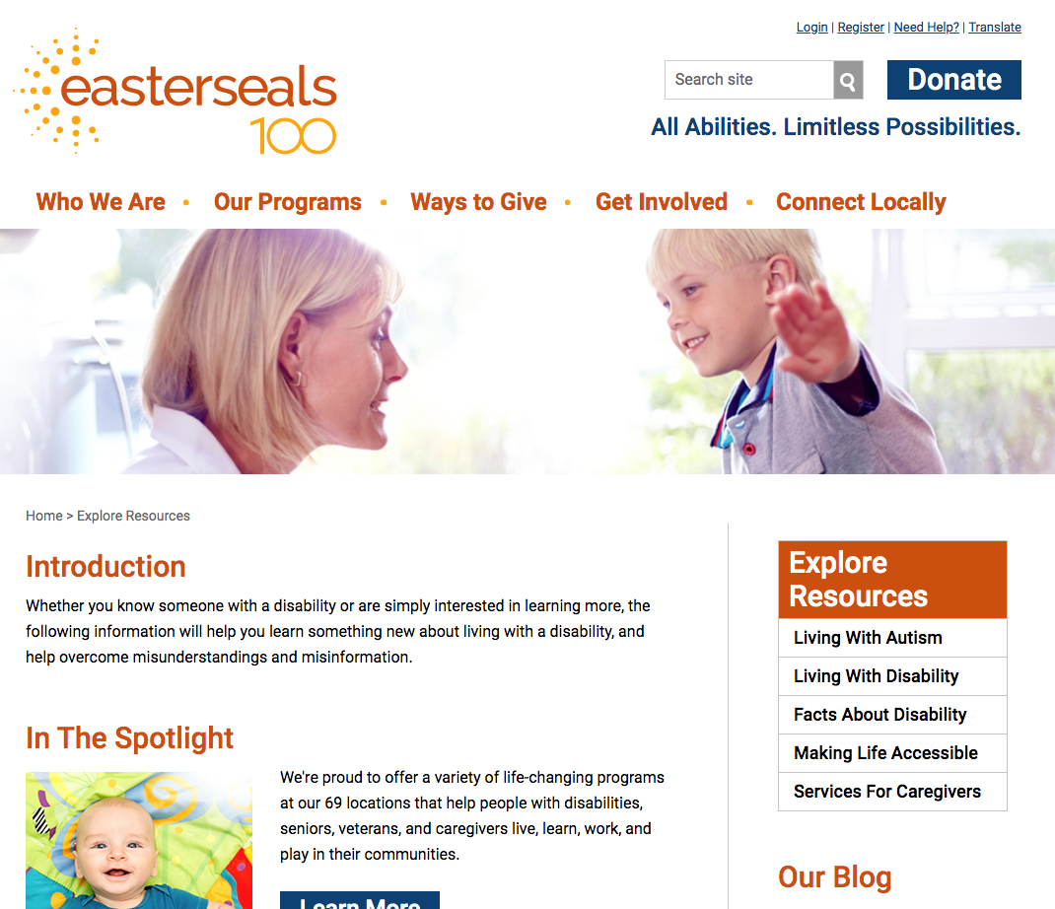
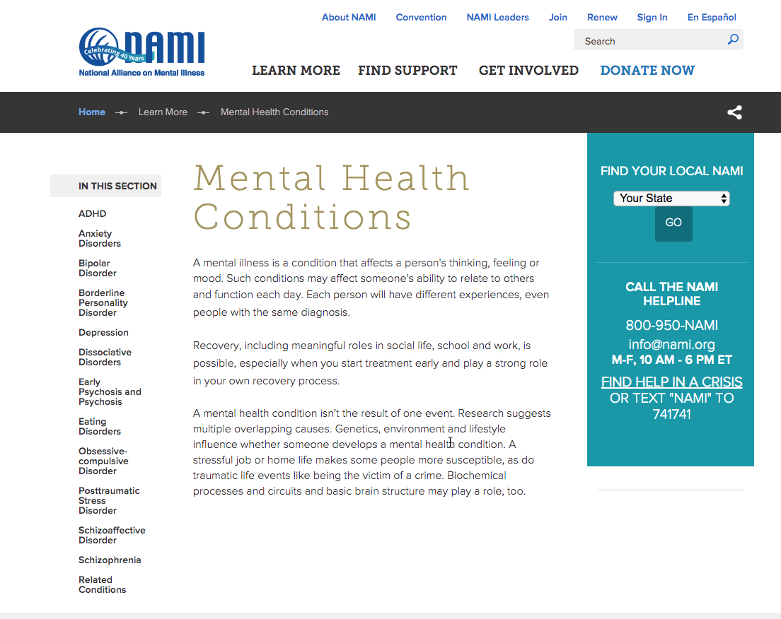
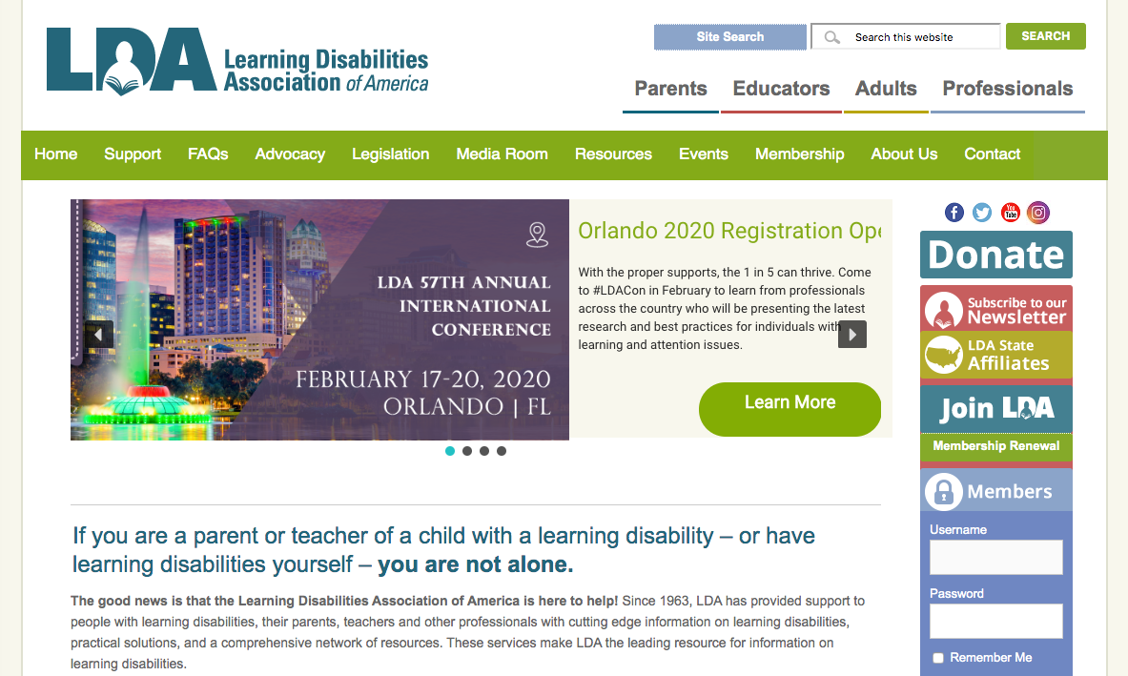
Issues Regarding Specific Disabilities
Conduct research online
There is an association for everything
Use state and local resources

Slide 28
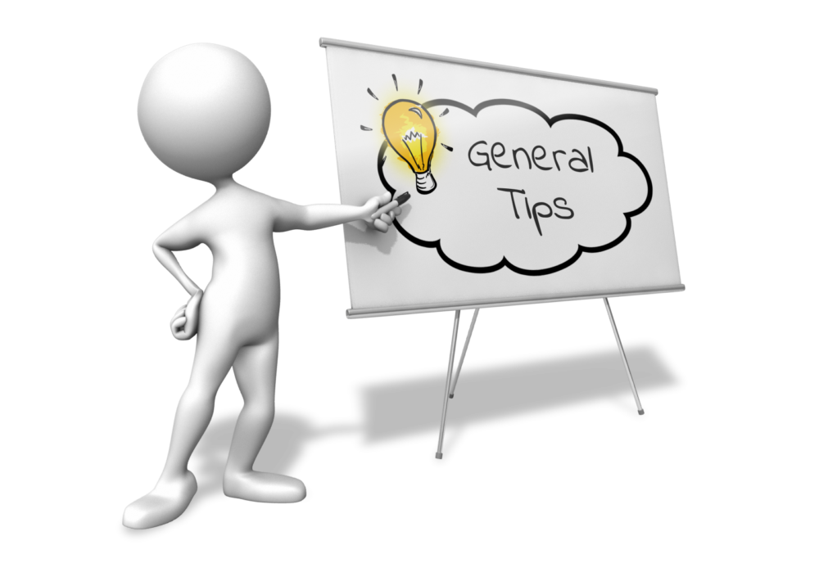

Create an atmosphere of general openness and welcoming to all
Don’t be afraid of saying or doing the wrong thing
Remember: the individual is the best source of information

Slide 29

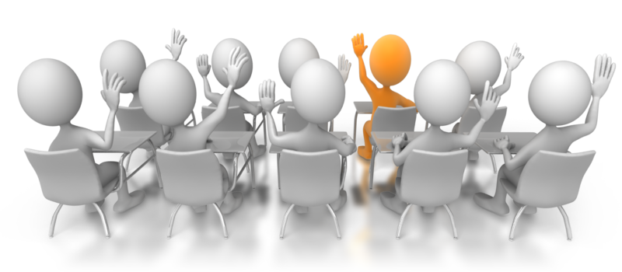
Discussion:
Creating a Welcoming Atmosphere in the Classroom

Slide 30


Slide 31
Handouts
PowerPoint
Common Myths and Misperceptions About Disability
Disability: What do we mean?
Disability: Basic Etiquette
Disability language guide
People First vs. Identity First
Article: How to Avoid Inspiration Porn
Article: Addressing Mental Health Concerns in the Classroom

Slide 32
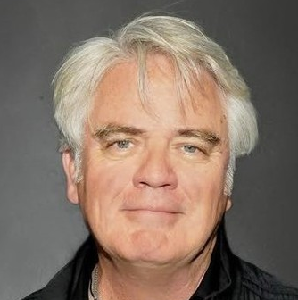
“We deal with people that are struggling with mental illness, developmental delays, or different ways of being, and we still largely have [this idea] in our collective consciousness that they're to be put off to the side.
I know that by making a conscious decision to be present with these people and to support them, to go the extra mile, and to spend time with them helping them process things...I know that that works.
I know that people get led to their lives that way.”
Michael Harney, Actor

